Slide 1
Title I Annual Parent Meeting
Ponce de Leon Elementary School
August 19, 2020
4:00PM
Virtual
Principal: Antonio Smith

Slide 2
About Title I
Title I is the largest federal assistance program for our nation’s schools.
The goal of Title I is a higher quality of education for every child. Its purpose is to address the academic needs of students and to assist them in meeting their state’s academic standards.
The program serves millions of children in public elementary and secondary schools each year including eligible students in non-public schools.

Slide 3
Title I Funding
The federal government provides funding to states each year for the Title I program.
The Florida Department of Education sends the funding to our Pinellas County School district.
The school district identifies eligible schools and distributes the Title I funds to the school.
Ponce de Leon Elementary School implements a Title I Schoolwide Plan. All students and staff benefit from the supplemental services.

Slide 4
Title I Programs Provide Supplemental Support
Additional supplemental personnel (MTSS Coach & Hourly Teachers)
Additional training opportunities for school staff (Collaborative Planning across all subject-areas for teachers)
Extended Learning Opportunities (before and/or after school programs)
Parent and Family Engagement Resources and Training Workshops
Supplemental teaching materials, equipment, and technology

Slide 5
Title I Schoolwide Planning
Input from school, family, and community members determine how Title I funds are used based on a needs assessment.
Please attend online or in-person meetings/trainings and complete surveys to provide input on Title I funding.
All Title I schools must document that parents are involved in the schoolwide planning process.

Slide 6
Title I Schoolwide Budget
Ponce de Leon Elementary School is provided ($195, 536.00) to pay for supplemental resources and programs for increased student achievement.
Title I hourly teachers used to support intervention across all grade levels, Connect for Success Program provides a digital device for our students to use at home to access computer-based learning programs. Our teachers are also paid stipends to participate in professional development and collaborative planning after school. The MTSS Coach monitors both academic and behavioral student data to help make informed decisions and to match students with the right interventions

Slide 7
Title I Parent & Family Engagement Budget
Ponce de Leon Elementary is provided $7, 750.00 to pay for supplemental resources and programs for increased student achievement.
Family Academic Nights
Parent Academy
Literacy Night
Curriculum resources for home use

Slide 8
Parent’s Right to Know
As a parent of a student attending a Pinellas County School Public School, you have the right to…
Be provided information on your child’s level of achievement on assessments in Reading/Language Arts, Writing, Mathematics, and Science.
Request and receive information on the qualifications of your child’s teacher and supplemental personnel working with your child.
Be notified of non-highly qualified or out-of-field teachers at the school.
Be informed if your child is taught by a non-highly qualified teacher for four or more consecutive weeks.

Slide 9
Parent’s Right to Know
Title I law requires that all Title I schools and families work together.
As a Title I parent you have the right to be involved in the development of the following plans and documents for our school:
School Improvement Plan (SIP)
Title I Schoolwide Plan
Parent and Family Engagement Plan (PFEP) for the school and district
School-Parent-Student Compact
You may request and attend virtual or in-person meetings to express your opinions and to formulate suggestions and to participate, as appropriate, in decisions relating to the education of your children.

Slide 10
Working Together for Student Success
Where are these documents located?
Please review these documents at the Parent Station and the school and district websites. We invite you to attend meetings or complete surveys to share your input…we need and want you to be involved.
Check out our website https://www.pcsb.org/Domain/62 to view:
School Improvement Plan (SIP)
Title I Schoolwide Plan
School Level Parent and Family Engagement Plan (PFEP)
Parent-School-Student Compact
Pinellas County School’s Parent and Family Engagement Plan at www.pcsb.org/titleone and a summary is written in, “Title I Family & School Partnership Overview”, which is given to all Title I families.

Slide 11
Title I Parent Station
Our school’s Title I Parent Station is located in the Front Office.
You will find a copy of our School Improvement Plan, Title I Schoolwide Plan, School’s PFEP, the School District’s PFEP, Parent’s Right to Know Memo, Upcoming Events, Compact,

Slide 12
Parent-School-Student Compact
Every Title I school has a Compact or Agreement.
The purpose of the compact is to foster student achievement. By signing the Parent-School-Student Compact, Ponce de Leon Elementary School, teachers, staff, parents and students agree to work together to share the responsibility of helping students meet or exceed state, district and school academic goals.
The Parent-School-Student Compact is updated every year to include parent, student, teacher, and staff input. Parent, student, teacher and staff comments are welcome at any time during the year.
Please review and sign your child’s Compact.
Our goal is to receive 100% participation!

Slide 13
Parent-Student-School Compact

Slide 14
Parent and Family Engagement Plan (PFEP)
The PFEP Sections include information about the following:
Parent trainings to increase student achievement
Staff trainings for engaging parents
Communication methods between home and school
Flexible meeting times
Accessibility for parents
Coordinating with other Federal Programs
Notes:
At Ponce de Leon, we understand your involvement in your child’s education is critical. Please consider joining our School Advisory Council which virtually meets on the 2nd Monday of each month from 5:30-6:00PM. We would also love if your joined our PTA, which meets on the 2nd Monday of each month, following the School Advisory Council meeting. PTA meetings are held from 6:00PM-6:30PM.
Additionally, the Parent and Family Engagement Plan (PFEP) provides free parent trainings to improve student academic outcomes. The plan also outlines ways to increase family involvement in our school and effective ways to communicate between home and school.

Slide 15
Parent Advisory Council (PAC)
The District has a Parent and Family Engagement Plan. The summary of the this plan is in the Title I School & Family Partnership Overview.
You may access the full plan at www.pcsb.org/titleone
The Parent Advisory Council (PAC) is responsible for reviewing and revising the District PFEP.
PAC will meet virtually or in-person with the district’s Title I Family Education Coordinator.
PAC meets twice a year, if you are interested in representing our school please notify, Tricia Wheeldon at wheeldont@pcsb.org.

Slide 16
Accountability
School Report Cards
School Grade and Overview
Population and Enrollment
Assessments – Academic Achievement, Growth, and Population
Assessments – English Language Learners
Graduation and Beyond
Educator Qualifications and Equity
Long-Term Goals and Interim Progress
Accelerated Course Enrollment
Per-Pupil Expenditures
National Data
Available online at https://edudata.fldoe.org/ or Front Office

Slide 17
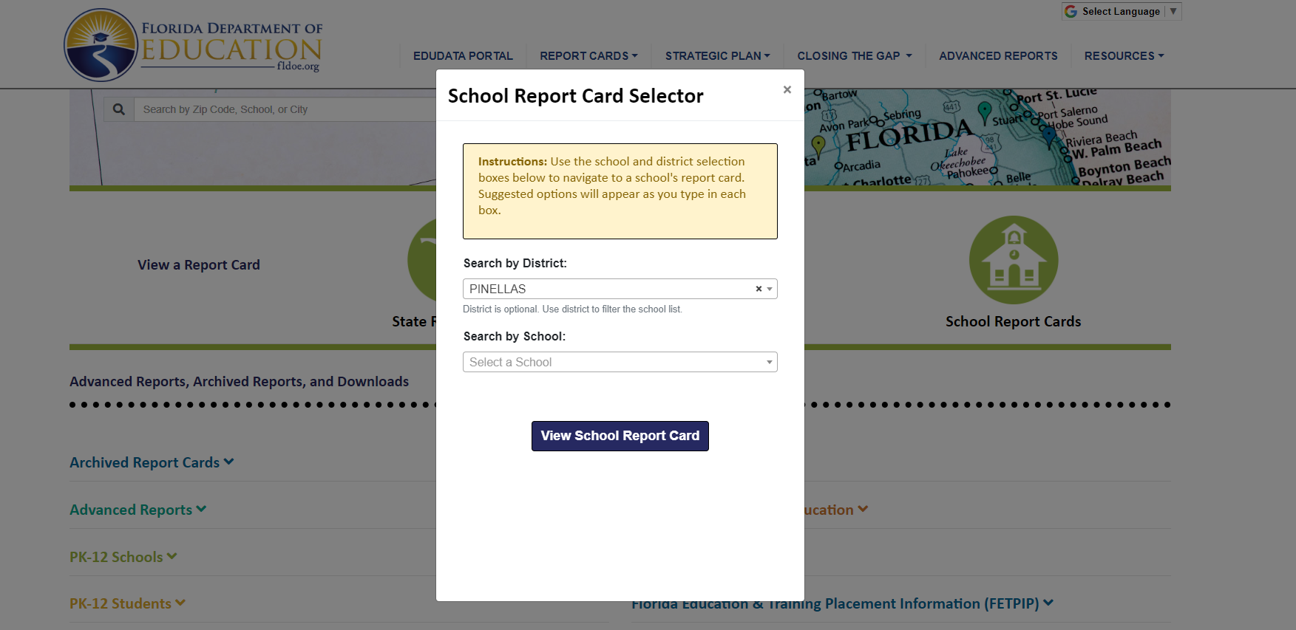
Visit to find district and school grades, EduData Portal

Slide 18
School Classification
Ponce de Leon Elementary a ‘C’ school. This year, our teachers will receive stipend pay to participate in professional development to increase their knowledge and expertise in teaching academic standards. Title I Hourly teachers will be used to assist with intervention. Students will receive research-based intervention to meet their individual needs.

Slide 19
Florida Standards
Florida’s academic content standards establish high expectations for all students.
Florida Standards identify what your child needs to know and be able to do in all content areas. You may read more information by visiting fldoe.org/academic/standards/.
Also, your child’s teacher will be able to explain the standards for your child’s grade level.

Slide 20
School’s Curriculum
Florida’s Standards form the framework of everything taught at school.
Curriculum
Reading – District ELA Modules
Mathematics – Classroom Mathematics
Writing – District Modules
Science – District Science Curriculum Resources

Slide 21
Florida Standards Assessment (FSA)
Fall Assessment-
FLKRS (Florida Kindergarten Readiness Assessment)
August 24th – October 5th
Spring Assessments-
3rd Grade Reading – April 5-16th
4th & 5th Grade Writing – April 5th -16th
4th & 5th Grade Reading- May 3rd -14th
3rd, 4th , & 5th Mathematics – May 3rd – 14th
Science Grs 5 and 8 – May 10th – 21st

Slide 22
Florida Benchmark For Excellent Student Thinking Standards (B.E.S.T). You may read more information by visiting, http://www.fldoe.org/standardsreview/

Slide 24
We need your help! Active Parent Involvement
Share a love of learning
Read to and with your child
Review the Compact throughout the year
Keep Portal info up to date
Volunteer
Participate in giving your input for our SIP, PFEP, and budget
Show interest in your child’s school day
Ask her/him questions
Check homework
Praise their efforts
Encourage good study habits
Communicate with the teachers and other staff
Virtually or in-person attend events

Slide 25
Working Together for Student Success
Please join us virtually or in-person…
School Advisory Council (SAC) meets virtually the 2nd Monday of each month from 5:30PM-6:00PM

Slide 26
Additional Resources
Title I Parent & Family Coordinator – Amy Brown
dodgeam@pcsb.org
Learning at Home Family Resources - https://www.pcsb.org/Page/32836
Volunteer in a Pinellas County School - https://www.pcsb.org/Page/459
Mentoring & Tutoring - This Year it's Virtual -https://www.pcsb.org/Page/461
Parent Advocacy – Keosha Simmons simmonskeo@pcsb.org
Parent Academy POWER HOURS Webinars - https://www.pcsb.org/Page/26534
Partnerships - https://www.pcsb.org/Page/418

Slide 27
We appreciate your time!
Please feel free to ask any questions and provide feedback on our Title I Program.

Slide 28
Contact Us
Insert school logo here
Ponce de Leon Elementary School
1301 Ponce de Leon Blvd. Clearwater, FL, 33756.
Phone: 727-588-3573
Fax: 727-588-3700

